Slide 1
Open System Interconnection (OSI) Specifications

Slide 2
Table of Contents
What is OSI Reference Model?
Layers of OSI Model
Data Encapsulation

Slide 3
What is OSI Reference Model?
1
Notes:
Kablolu ve kablosuz ağlar için IEEE
80 yılınınn şubat ayında çıkmış

Slide 4
What is OSI Reference Model?
The OSI provides a standard for different computer systems to be able to communicate with each other
Developed by ISO in 1984
Notes:
In the beginning, the development of networks was chaotic. Each vendor had its own proprietary solution. The bad part was that one vendor’s solution was not compatible with another vendor’s solution. This is where the idea for the OSI model was born, having a layered approach to networks our hardware vendors would design hardware for the network, and others could develop software for the application layer. Using an open model which everyone agrees on means we can build networks that are compatible with each other.
To fix this problem the International Organization for Standardization (ISO) researched different network models and the result is the OSI-model which was released in 1984. Nowadays most vendors build networks based on the OSI model and hardware from different vendors is compatible

Slide 5
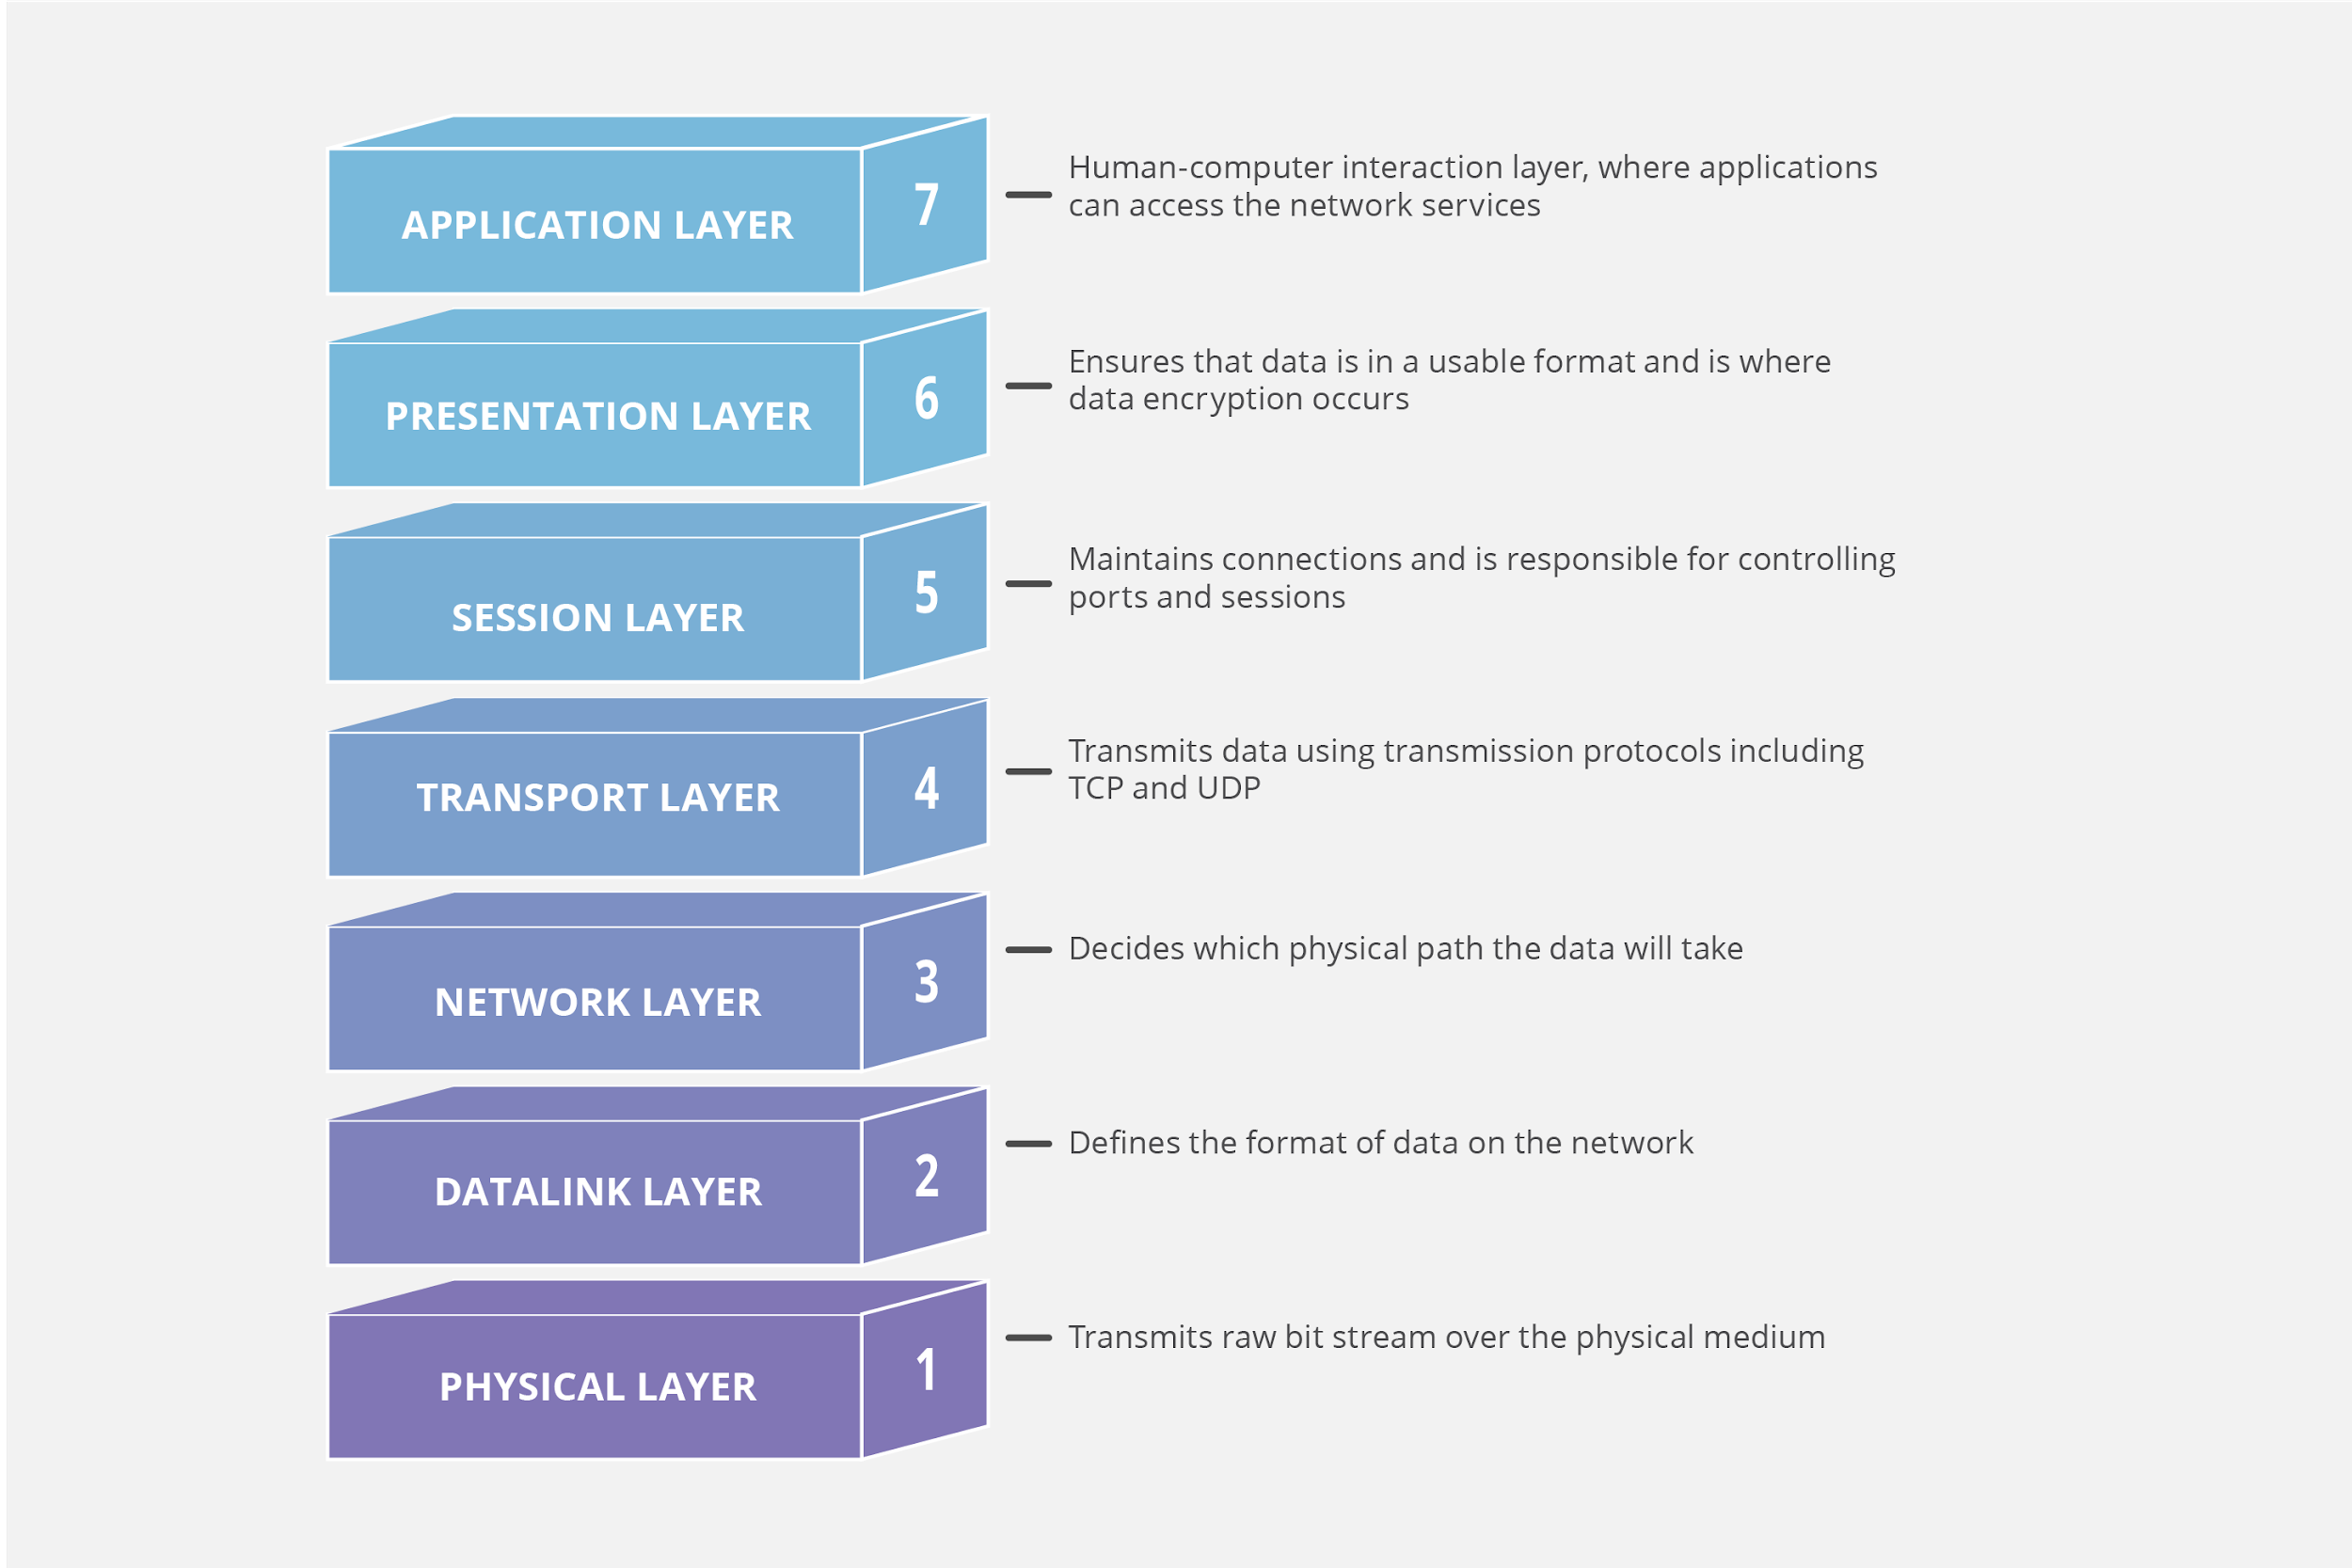
What is OSI Reference Model?
- Human-computer interaction layer, where applications can access the network services
Upper Layers
(OS)
- Ensures that data is in a usable format and is where data encryption occurs
- Maintains connections and is responsible for controlling ports and sessions
- Transmits data using transmission protocols including TCP and UDP
- Decides which physical path the data will take
Lower Layers
(Network)
- Defines the format of the data on the network
- Transmits raw bit stream over the physical medium
Notes:
Rooter 4 katman
Switch en alt 2 katman
Her internet yazılımı 7 de
4 de tcp ve udp denseçilene göre ek bilgiler geliyor
Paketlere ayrılıyor numaralandırıyor
3 de hedef IP kaynak Ip
2 mac adresleri ekleniyor
1 bit seviyesinde iletim
The OSI model can be seen as a universal language for computer networking. It’s based on the concept of splitting up a communication system into seven abstract layers, each one stacked upon the last.
As the complexity of computer hardware and software increases, the problem of successfully communicating between these systems becomes more difficult. Dividing these difficult problems into "sub-tasks" allows them to be readily understood and solved more easily. Using this layered approach means that a vendor can work on the design and debugging for a particular layer without affecting any of the others.
upper layers - Operating system and applications/software
lower layers - Network and physical media

Slide 6
Layers of the OSI Model
2
Physical Layer
Data Link Layer
Network Layer
Transport Layer
Session Layer
Presentation Layer
Application Layer

Slide 7
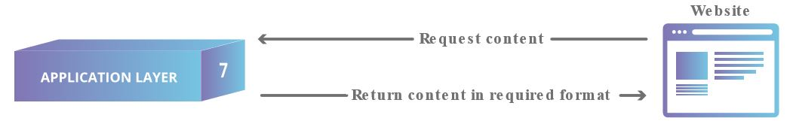
Application Layer (Layer 7)
Directly interacts with data from the user
Software applications (web browsers, email clients, etc.) rely on the application layer to initiate communications
Notes:
This is the only layer that directly interacts with data from the user. Software applications like web browsers and email clients rely on the application layer to initiate communications. But it should be made clear that client software applications are not part of the application layer; rather the application layer is responsible for the protocols and data manipulation that the software relies on to present meaningful data to the user. Application layer protocols include HTTP as well as SMTP (Simple Mail Transfer Protocol is one of the protocols that enables email communications).

Slide 8
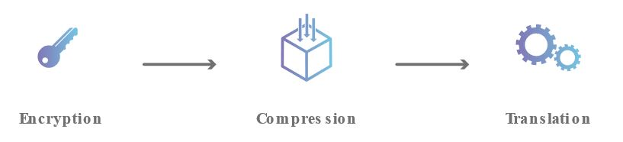
Presentation Layer (Layer 6)
Primarily responsible for preparing data
Translates, encrypts, and compresses data
Notes:
This layer is primarily responsible for preparing data so that it can be used by the application layer; in other words, layer 6 makes the data presentable for applications to consume. The presentation layer is responsible for translation, encryption, and compression of data.
Two devices communicate using may be different encoding methods, so layer 6 is responsible for translating incoming data into a syntax that the application layer of the receiving device can understand.
If the devices are communicating over an encrypted connection, layer 6 is responsible for adding the encryption on the sender’s end as well as decoding the encryption on the receiver's end so that it can present the application layer with unencrypted, readable data.
Finally the presentation layer is also responsible for compressing data it receives from the application layer before delivering it to layer 5. This helps improve the speed and efficiency of communication by minimizing the amount of data that will be transferred.

Slide 9
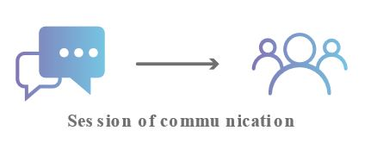
Session Layer (Layer 5)
Responsible for opening and closing communication between the two devices
The time between when the communication is opened and closed is known as the session
Synchronizes data transfer
Notes:
This is the layer responsible for opening and closing communication between the two devices. The time between when the communication is opened and closed is known as the session. The session layer ensures that the session stays open long enough to transfer all the data being exchanged, and then promptly closes the session in order to avoid wasting resources.
The session layer also synchronizes data transfer with checkpoints. For example, if a 100 megabyte file is being transferred, the session layer could set a checkpoint every 5 megabytes. In the case of a disconnect or a crash after 52 megabytes have been transferred, the session could be resumed from the last checkpoint, meaning only 50 more megabytes of data need to be transferred. Without the checkpoints, the entire transfer would have to begin again from scratch.

Slide 10
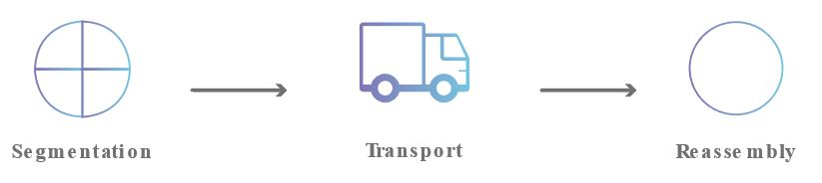
Transport Layer (Layer 4)
Responsible for end-to-end communication between the two devices
Takes data (from upper layer) and breaks into segments
Responsible for flow control and error control
Notes:
Layer 4 is responsible for end-to-end communication between the two devices. This includes taking data from the session layer and breaking it up into chunks called segments before sending it to layer 3. The transport layer on the receiving device is responsible for reassembling the segments into data the session layer can consume.
The transport layer is also responsible for flow control and error control. Flow control determines an optimal speed of transmission to ensure that a sender with a fast connection doesn’t overwhelm a receiver with a slow connection. The transport layer performs error control on the receiving end by ensuring that the data received is complete, and requesting a retransmission if it isn’t.

Slide 11

Network Layer (Layer 3)
Facilitates data transfer between two different networks
Takes data segments (from upper layer) and breaks into packets
Notes:
The network layer is responsible for facilitating data transfer between two different networks. If the two devices communicating are on the same network, then the network layer is unnecessary. The network layer breaks up segments from the transport layer into smaller units, called packets, on the sender’s device, and reassembling these packets on the receiving device. The network layer also finds the best physical path for the data to reach its destination; this is known as routing.

Slide 12
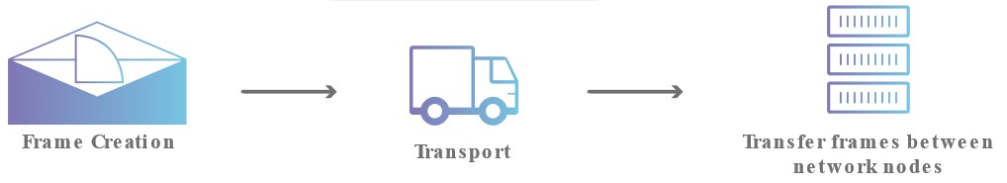
Data Link Layer (Layer 2)
Facilitates data transfer between two devices on the same network
Takes data packets (from upper layer) and breaks into frames
Responsible for flow control and error control
Notes:
The data link layer facilitates data transfer between two devices on the SAME network. The data link layer takes packets from the network layer and breaks them into smaller pieces called frames. Like the network layer, the data link layer is also responsible for flow control and error control in intra-network communication

Slide 13
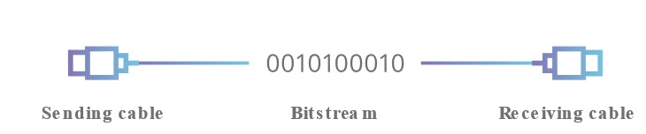
Physical Layer (Layer 1)
Includes physical equipment
cables repeaters modems
transceivers media converters hubs
etc.
Data is converted into bit streams
Notes:
This layer includes the physical equipment involved in the data transfer, such as the cables and switches. This is also the layer where the data gets converted into a bit stream, which is a string of 1s and 0s. The physical layer of both devices must also agree on a signal convention so that the 1s can be distinguished from the 0s on both devices.

Slide 14
Data Encapsulation
3

Slide 15
Data Encapsulation
For two nodes communicate they must use the same protocol
Each layer (OSI or DoD) communicates with its equivalent layer on the other node via the lower layers of the model
Each layer provides services for the layer above and uses the services of the layer below
Notes:
For two nodes to communicate they must be running the same protocol. Each layer communicates with its equivalent (or peer) layer on the other node via the lower layers of the model. Each layer provides services for the layer above and uses the services of the layer below.

Slide 16
Data Encapsulation
Notes:
4 fr data
3 de segment parçalara ayrılıyor
2 frame
1 sinyal
Bir düğümden diğerine bir mesaj gönderildiğinde, gönderen düğümdeki katman yığınında aşağı doğru hareket eder, iletim ortamını kullanarak alıcı düğüme ulaşır ve sonra bu düğümdeki yığında yukarı geçer. Her düzeyde (fiziksel katman hariç), gönderen düğüm, bir Protokol Veri Birimi (PDU) oluşturan veri yüküne bir başlık ekler. Bu işlem kapsülleme olarak bilinir.Tipik bir yerel ağda, örneğin, gönderen düğümde, veriler, kendi uygulama başlığını içerecek olan HTTP gibi bir uygulama tarafından üretilir. Aktarım katmanında, bu uygulama verilerine bir TCP başlığı eklenir. Ağ katmanında, TCP segmenti bir IP başlığına sarılır. IP paketi, veri bağlantı katmanında bir Ethernet çerçevesine konur ve ardından çerçeveyi oluşturan bit akışı, fiziksel katmanda ağ üzerinden iletilir.Alıcı düğüm ters işlemi gerçekleştirir (kapsülden çıkarma veya kapsülden çıkarma). Örneğin, fiziksel katmana gelen bit akışını alır ve bir Ethernet çerçevesinin kodunu çözer. Bu çerçeveden IP paketini çıkarır ve IP başlığındaki bilgileri çözer, ardından aynısını TCP ve uygulama başlıkları için yapar ve sonunda bir yazılım programı tarafından işlenmek üzere uygulama verilerini çıkarır.Özetle, bir verici cihazda veri kapsülleme yöntemi şu şekilde çalışır:Kullanıcı bilgileri, ağ üzerinde iletilmek üzere verilere dönüştürülür.Veriler segmentlere dönüştürülür ve ileten ve alan ana bilgisayarlar arasında güvenilir bir bağlantı kurulur.Segmentler, paketlere veya datagramlara dönüştürülür ve her paketin bir ağ üzerinden yönlendirilebilmesi için başlığa mantıksal bir adres yerleştirilir.Paketler veya datagramlar, yerel ağda iletilmek üzere çerçevelere dönüştürülür. Donanım (Ethernet) adresleri, yerel bir ağ segmentindeki ana bilgisayarları benzersiz şekilde tanımlamak için kullanılır.Çerçeveler bit'e dönüştürülür ve dijital bir kodlama kullanılır.
When a message is sent from one node to another, it travels down the stack of layers on the sending node, reaches the receiving node using the transmission media, and then passes up the stack on that node. At each level (except the physical layer), the sending node adds a header to the data payload, forming a Protocol Data Unit (PDU). This process is known as encapsulation.
On a typical local network for example, on the sending node, data is generated by an application such as HTTP, which will include its own application header. At the transport layer, a TCP header is added to this application data. At the network layer, the TCP segment is wrapped in an IP header. The IP packet is put into an Ethernet frame at the data link layer then the stream of bits making up the frame is transmitted over the network at the physical layer.
The receiving node performs the reverse process (de-encapsulation or decapsulation). For example, it receives the stream of bits arriving at the physical layer and decodes an Ethernet frame. It extracts the IP packet from this frame and resolves the information in the IP header then does the same for the TCP and application headers, eventually extracting the application data for processing by a software program.
In summary, at a transmitting device, the data-encapsulation method works like this:
User information is converted to data for transmission on the network.
Data is converted to segments, and a reliable connection is set up between the transmitting and receiving hosts.
Segments are converted to packets or datagrams, and a logical address is placed in the header so each packet can be routed through an internetwork.
Packets or datagrams are converted to frames for transmission on the local network. Hardware (Ethernet) addresses are used to uniquely identify hosts on a local network segment.
Frames are converted to bits, and a digital encoding is used.

Slide 17
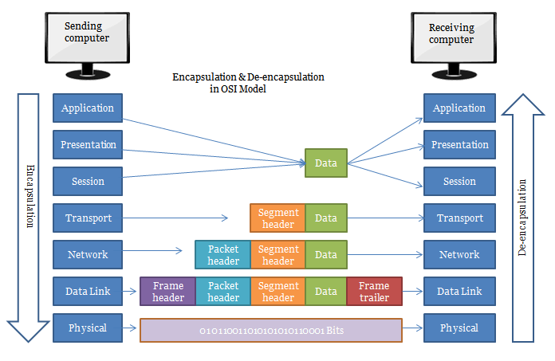
Data Encapsulation
Notes:
3 ıp ekleniyo
2 veri kontrol ekleri
Bir düğümden diğerine bir mesaj gönderildiğinde, gönderen düğümdeki katman yığınında aşağı doğru hareket eder, iletim ortamını kullanarak alıcı düğüme ulaşır ve sonra bu düğümdeki yığında yukarı geçer. Her düzeyde (fiziksel katman hariç), gönderen düğüm, bir Protokol Veri Birimi (PDU) oluşturan veri yüküne bir başlık ekler. Bu işlem kapsülleme olarak bilinir.Tipik bir yerel ağda, örneğin, gönderen düğümde, veriler, kendi uygulama başlığını içerecek olan HTTP gibi bir uygulama tarafından üretilir. Aktarım katmanında, bu uygulama verilerine bir TCP başlığı eklenir. Ağ katmanında, TCP segmenti bir IP başlığına sarılır. IP paketi, veri bağlantı katmanında bir Ethernet çerçevesine konur ve ardından çerçeveyi oluşturan bit akışı, fiziksel katmanda ağ üzerinden iletilir.Alıcı düğüm ters işlemi gerçekleştirir (kapsülden çıkarma veya kapsülden çıkarma). Örneğin, fiziksel katmana gelen bit akışını alır ve bir Ethernet çerçevesinin kodunu çözer. Bu çerçeveden IP paketini çıkarır ve IP başlığındaki bilgileri çözer, ardından aynısını TCP ve uygulama başlıkları için yapar ve sonunda bir yazılım programı tarafından işlenmek üzere uygulama verilerini çıkarır.Özetle, bir verici cihazda veri kapsülleme yöntemi şu şekilde çalışır:Kullanıcı bilgileri, ağ üzerinde iletilmek üzere verilere dönüştürülür.Veriler segmentlere dönüştürülür ve ileten ve alan ana bilgisayarlar arasında güvenilir bir bağlantı kurulur.Segmentler, paketlere veya datagramlara dönüştürülür ve her paketin bir ağ üzerinden yönlendirilebilmesi için başlığa mantıksal bir adres yerleştirilir.Paketler veya datagramlar, yerel ağda iletilmek üzere çerçevelere dönüştürülür. Donanım (Ethernet) adresleri, yerel bir ağ segmentindeki ana bilgisayarları benzersiz şekilde tanımlamak için kullanılır.Çerçeveler bit'e dönüştürülür ve dijital bir kodlama kullanılır.
When a message is sent from one node to another, it travels down the stack of layers on the sending node, reaches the receiving node using the transmission media, and then passes up the stack on that node. At each level (except the physical layer), the sending node adds a header to the data payload, forming a Protocol Data Unit (PDU). This process is known as encapsulation.
On a typical local network for example, on the sending node, data is generated by an application such as HTTP, which will include its own application header. At the transport layer, a TCP header is added to this application data. At the network layer, the TCP segment is wrapped in an IP header. The IP packet is put into an Ethernet frame at the data link layer then the stream of bits making up the frame is transmitted over the network at the physical layer.
The receiving node performs the reverse process (de-encapsulation or decapsulation). For example, it receives the stream of bits arriving at the physical layer and decodes an Ethernet frame. It extracts the IP packet from this frame and resolves the information in the IP header then does the same for the TCP and application headers, eventually extracting the application data for processing by a software program.
In summary, at a transmitting device, the data-encapsulation method works like this:
User information is converted to data for transmission on the network.
Data is converted to segments, and a reliable connection is set up between the transmitting and receiving hosts.
Segments are converted to packets or datagrams, and a logical address is placed in the header so each packet can be routed through an internetwork.
Packets or datagrams are converted to frames for transmission on the local network. Hardware (Ethernet) addresses are used to uniquely identify hosts on a local network segment.
Frames are converted to bits, and a digital encoding is used.

Slide 18
THANKS!
Any questions?

